Slide 1
The Internet and IP addressing

Slide 2
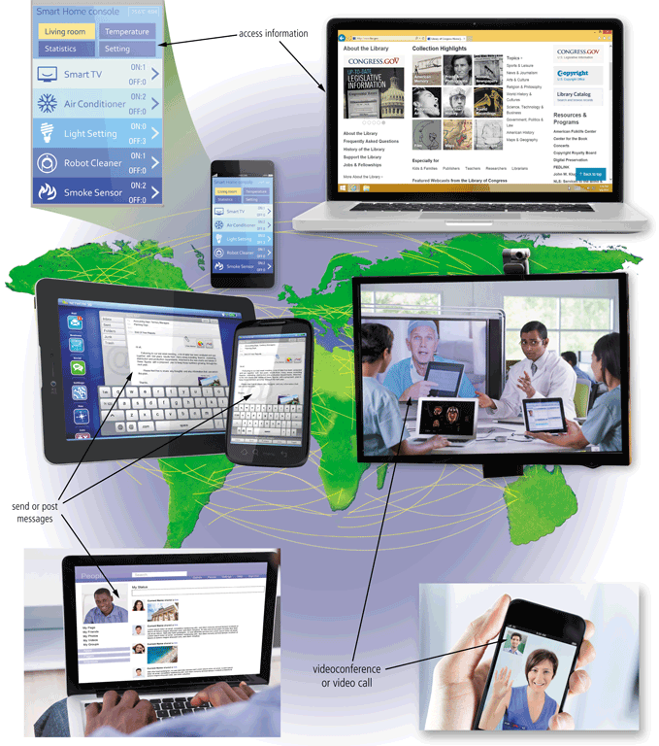
The Internet
The Internet is a worldwide collection of networks that connects millions of businesses, government agencies, educational institutions, and individuals
Pages 56 - 57
Figure 2-1

Slide 3
The Internet
The Internet originated as ARPANET in September 1969 and had two main goals:
Allow scientists at different physical locations to share information and work together
Function even if part of the network were disabled or destroyed by a disaster
Page 56

Slide 4
Connecting to the Internet
With wired connections, a computer or device physically attaches via a cable or wire to a communications device
Computers without a communications device can use a wireless modem or other communications device that enables wireless connectivity

Slide 5
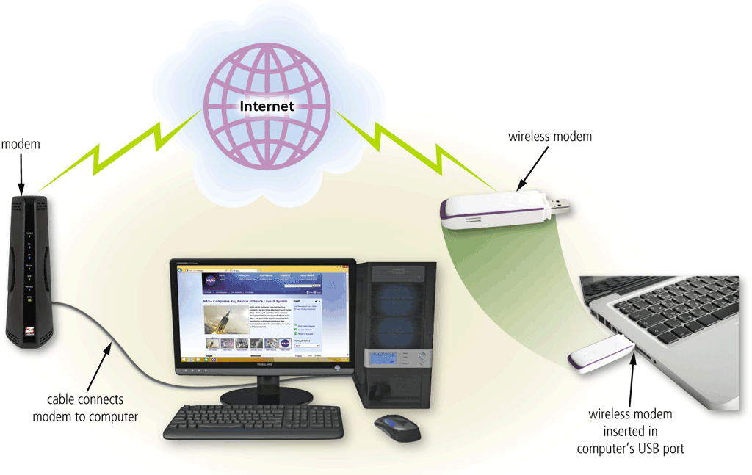
Connecting to the Internet
Page 58
Figure 2-2

Slide 6
Connecting to the Internet
Wired
Wireless
Cable Internet service
DSL (digital subscriber line)
Fiber to the Premises (FTTP)
Wi-Fi (wireless fidelity)
Mobile broadband
Fixed wireless
Satellite Internet Service
Page 59

Slide 7
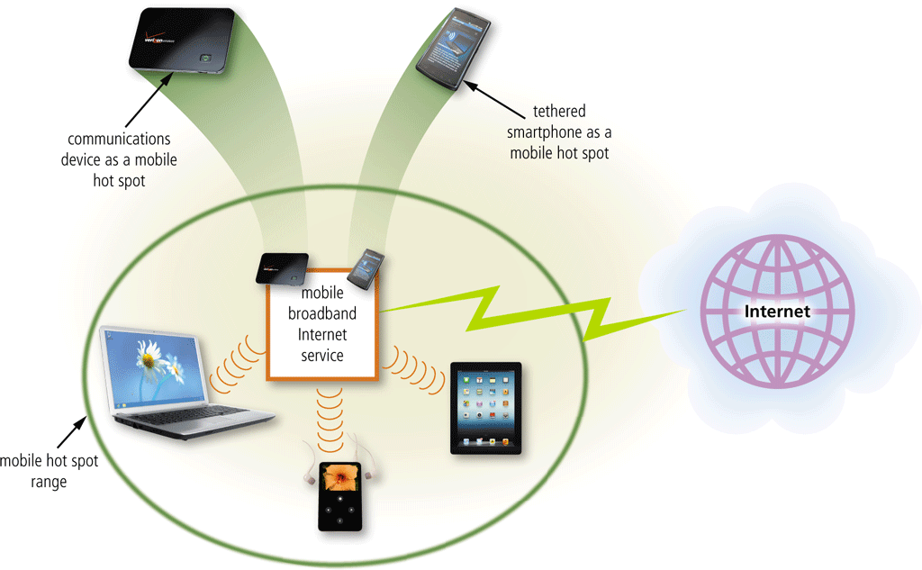
Connecting to the Internet
A hot spot is a wireless network that provides Internet connections to mobile computers and devices
Pages 59 - 60
Figure 2-3

Slide 8
Connecting to the Internet
An Internet service provider (ISP) is a business that provides individuals and organizations access to the Internet free or for a fee
Bandwidth represents the amount of data that travels over a network
Megabyte (MB)
Gigabyte (GB)
Page 58

Slide 9
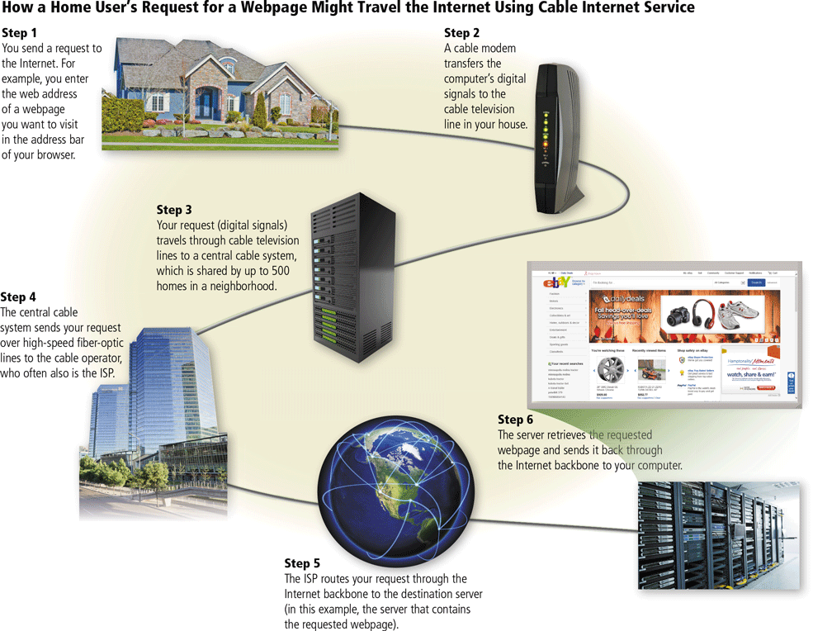
Connecting to the Internet
Page 62
Figure 2-4

Slide 10
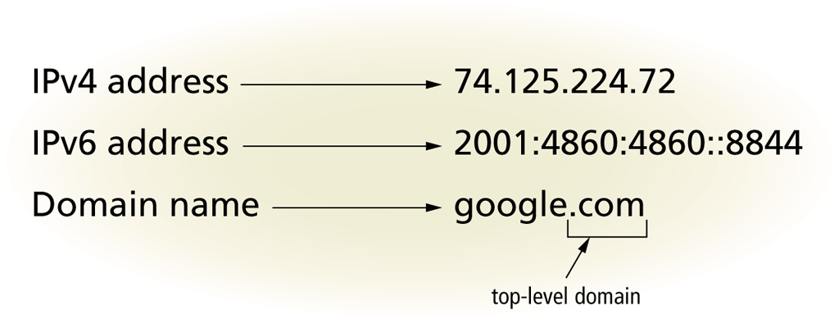
Connecting to the Internet
An IP address is a sequence of numbers that uniquely identifies each computer or device connected to the Internet
A domain name is a text-based name that corresponds to the IP address
A DNS server translates the domain name into its associated IP address
Pages 62 - 64
Figure 2-5

Slide 11
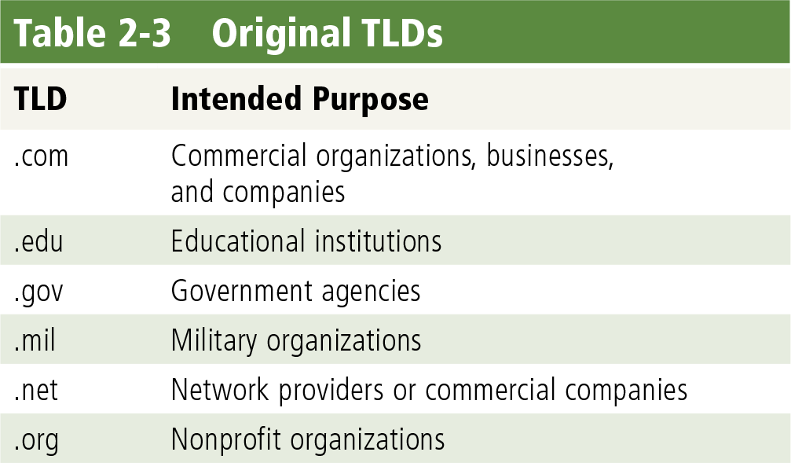
Connecting to the Internet
Page 63
Table 2-3

Slide 12
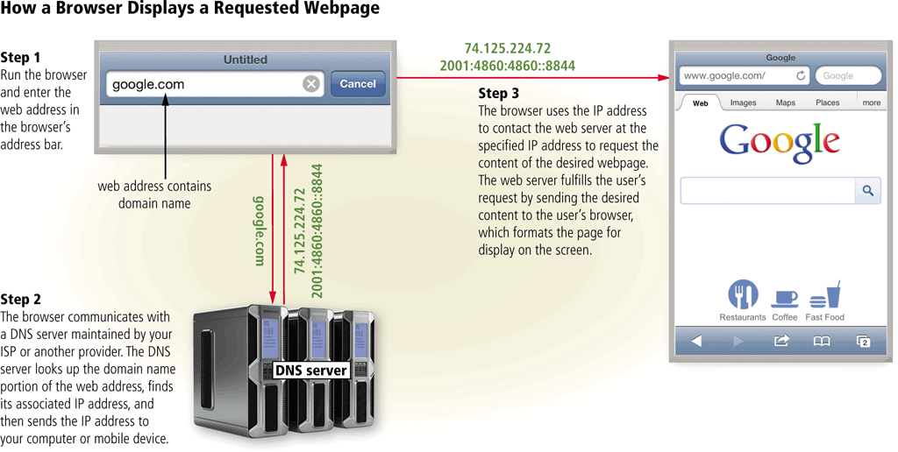
Connecting to the Internet
Page 64
Figure 2-6

Slide 13
IP Address
Unique Identifier
32 bit binary number
Represented as 4 decimal values
Representing 8 bits, in the range 0 – 255 (known as Octets)
Example: 140.179.220.200
Binary form:
10001100.10110011.11011100.11001000

Slide 14
Address Classes
Class A addresses begin with 0xxx, or 1 to 126 decimal.
Class B addresses begin with 10xx, or 128 to 191 decimal.
Class C addresses begin with 110x, or 192 to 223 decimal.
Class D addresses begin with 1110, or 224 to 239 decimal.
Class E addresses begin with 1111, or 240 to 254 decimal.
DEFAULT SUBNET MASK
Class A - 255.0.0.0 - 11111111.00000000.00000000.00000000
Class B - 255.255.0.0 - 11111111.11111111.00000000.00000000
Class C - 255.255.255.0 - 11111111.11111111.11111111.00000000

Slide 15
Why Subnet?
To break the network down into pieces, each of which can be addressed separately.
Controls network traffic
Reduces broadcasts
Can provide low level security with access lists on the router
Organization of IP addresses

Slide 16
Transmission Modes
Transmission mode refers to the mechanism of transferring of data between two devices connected over a network.
It is also called Communication Mode. These modes direct the direction of flow of information
There are three modes of transmission, namely: simplex, half duplex, and full duplex.

Slide 17
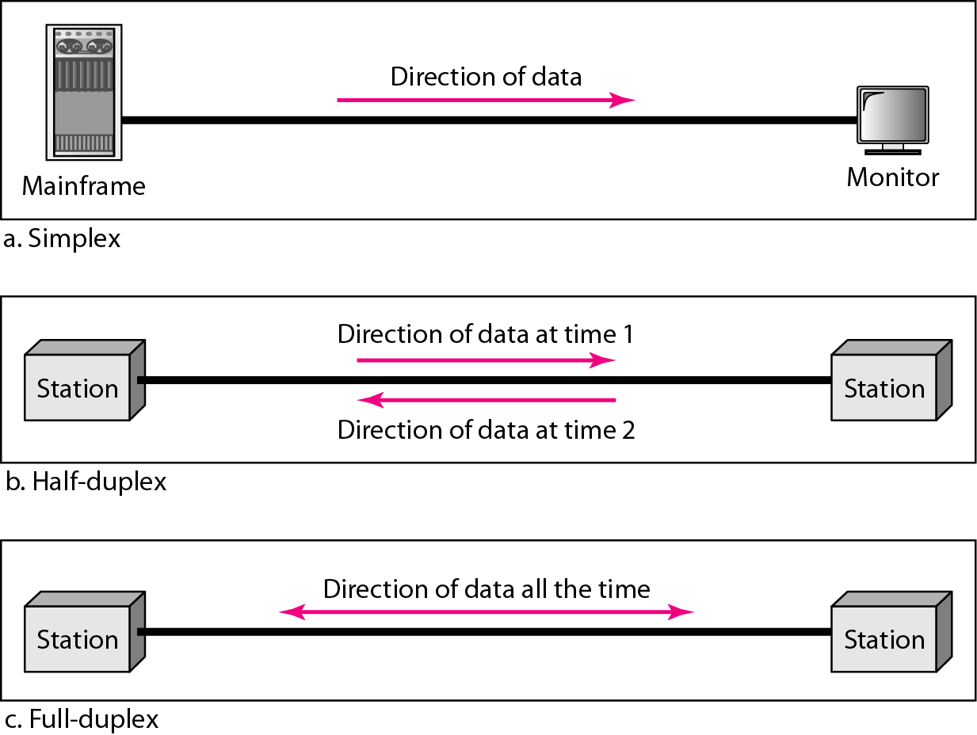
Transmission Modes

Slide 18
Data Flow
Simplex
Unidirectional
As on a one-way street
Half-duplex
Both transmit and receive possible, but not at the same time
Like a one-lane road with two-directional traffic
Walkie-talkie, CB radio
Full-duplex
Transmit and receive simultaneously
Like a two-way street, telephone network
Channel capacity must be divided between two directions

Slide 19
Thank You!

